Slide 1
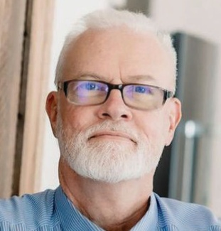
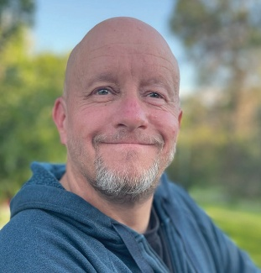
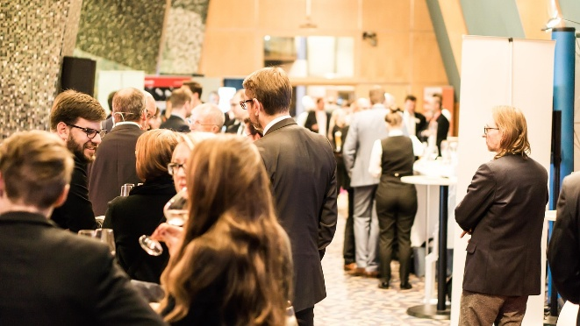
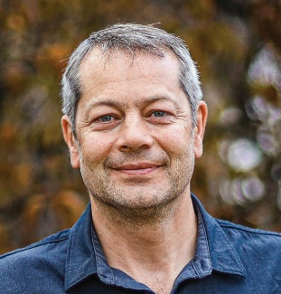
Hearts Restored Simulcast
Biblical Foundations for Families in Crisis
Trailview Alliance Church
June 21, 2025
Doors open: 9:00 AM
Charles Redwine
James Simpson
Building Trust in the Midst of Addiction
The Role of Community in Family Healing
God’s Redemptive Work in Crisis
Dallas Block
Presented by:
Notes:
We’re about to watch a video in which James, one of our staff members, shares his heart for this ministry. This is only a part of the 10 Years in the Making video we made, you can watch the whole thing on our website.

